Slide 1
Genetic Programming
Chapter 6

Slide 2
GP quick overview
Developed: USA in the 1990’s (youngest member of EC!)
Early names: J. Koza
Typically applied to:
  machine learning tasks (prediction, classification, modeling…)
  Seek models with maximum fit
  (vs ES for optimization problem)
Attributed features:
  competes with neural nets and alike
  needs huge populations (thousands)
  slow
Special:
  non-linear chromosomes: trees, graphs
  mutation possible but not necessary (disputed!?)

Slide 3

John Koza with 1,000-Pentium parallel computer in Mountain View, California.

Slide 4
GP technical summary tableau
Representation | Tree structures
Recombination | Exchange of sub-trees
Mutation | Random change in trees
Parent selection | Fitness proportional
Survivor selection | Generational replacement

Slide 5
Introductory example: credit scoring
Bank wants to distinguish good from bad-loan applicants
Develop a model (classification model) that matches historical data
To predict customer’s behaviors and assist in evaluating future loan applicants.
ID | No of children | Salary | Marital status | Credit OK?
ID-1 | 2 | 45000 | Married | 0
ID-2 | 0 | 30000 | Single | 1
ID-3 | 1 | 40000 | Divorced | 1
…

Slide 6
The classification model can be developed based on historical data (cf: NN alike), and produces a binary output (good/bad) for predicting the creditworthiness of the applicant (person).
A possible model:
IF (NOC = 2) AND (S > 80000) THEN good ELSE bad
In general, the model might look like this:
IF formula THEN good ELSE bad
Only unknown is the right (optimal) formula, hence, our search space (phenotypes) is the set of formulas (find the optimal formula). ➔ modelling
Fitness of a formula: percentage of customers correctly classified by the model (classification accuracy).
Natural representation of formulas (phenotypes) is: parse trees (語法樹 ) (genotypes)

Slide 7
Introductory example: credit scoring
IF (NOC = 2) AND (S > 80000) THEN good ELSE bad
can be represented by the following tree
AND
=
>
NOC
2
S
80000
Parse tree

Slide 8
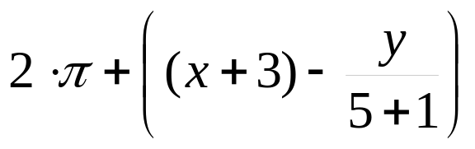
Tree-based representation
Trees (as chromosomes) are a universal form.
Depending the problem, the solutions may look like:
  Arithmetic formula:
  Logical formula:
  Program:
(x ∧ true) → (( x ∨ y ) ∨ (z ↔ (x ∧ y)))
i =1;
while (i < 20)
{
i = i +1
}
Notes:
A→B，意味著如果A為真，則B也為真；如果A為假，則對B沒有任何影響。imply
A←>B，意味著如果A為真則B為真，和如果A為假則 B為假。Equivalence
^ 是 AND。x ∧ true➔ x
logical OR (∨)

Slide 9
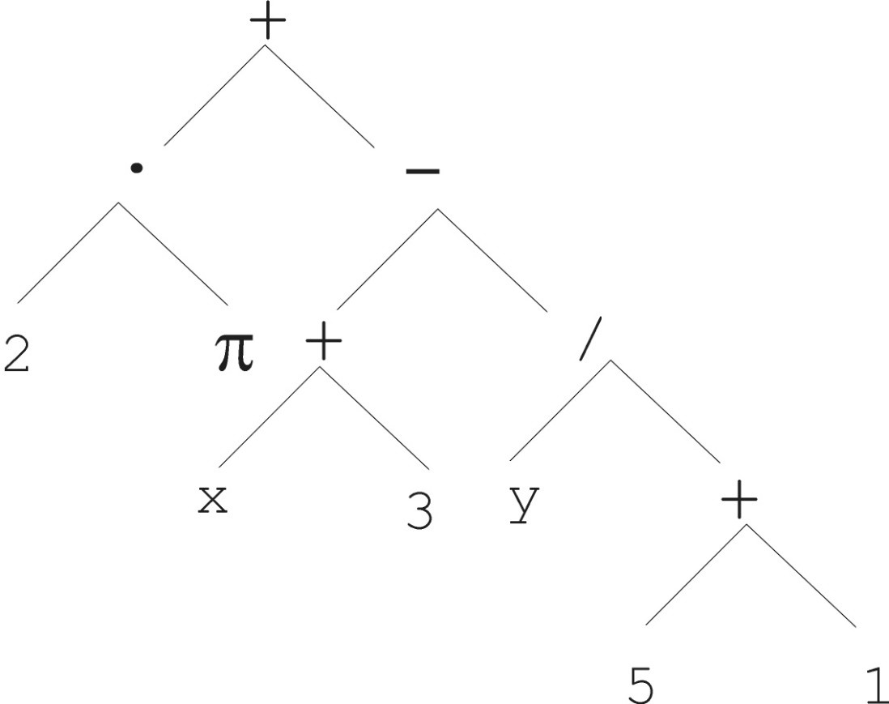
Tree-based representation

Slide 10
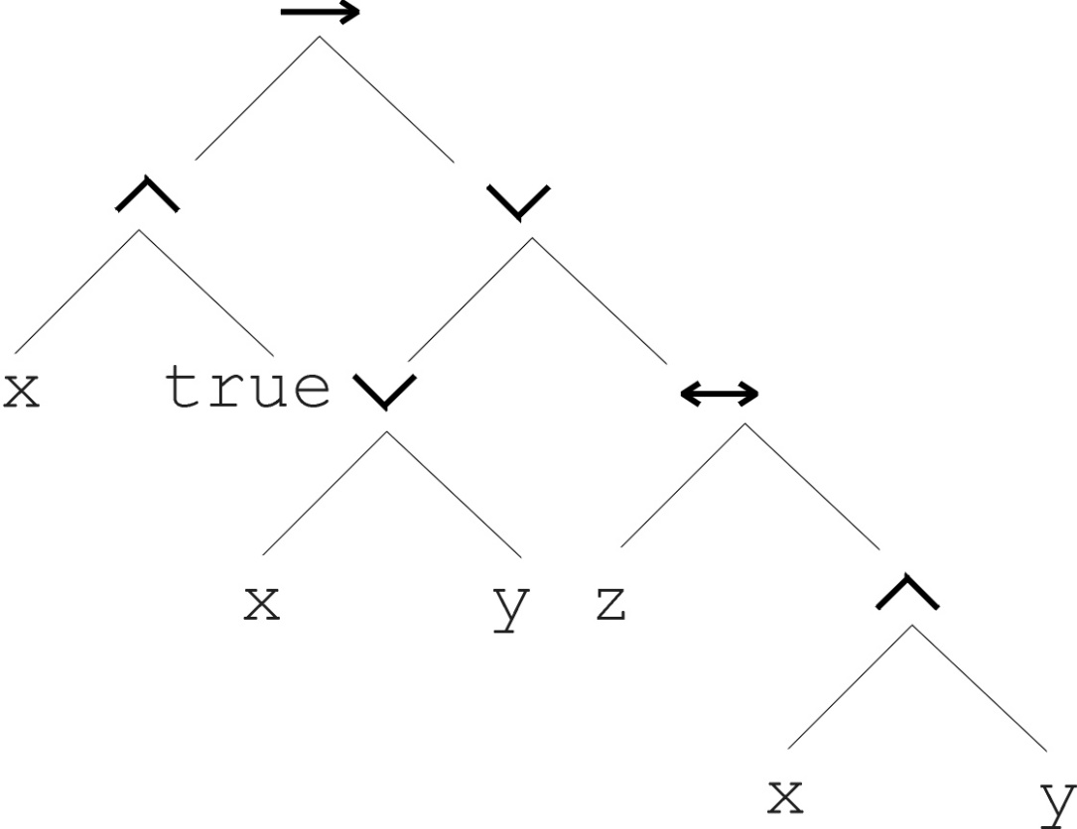
Tree-based representation
(x ∧ true) → (( x ∨ y ) ∨ (z ↔ (x ∧ y)))

Slide 11
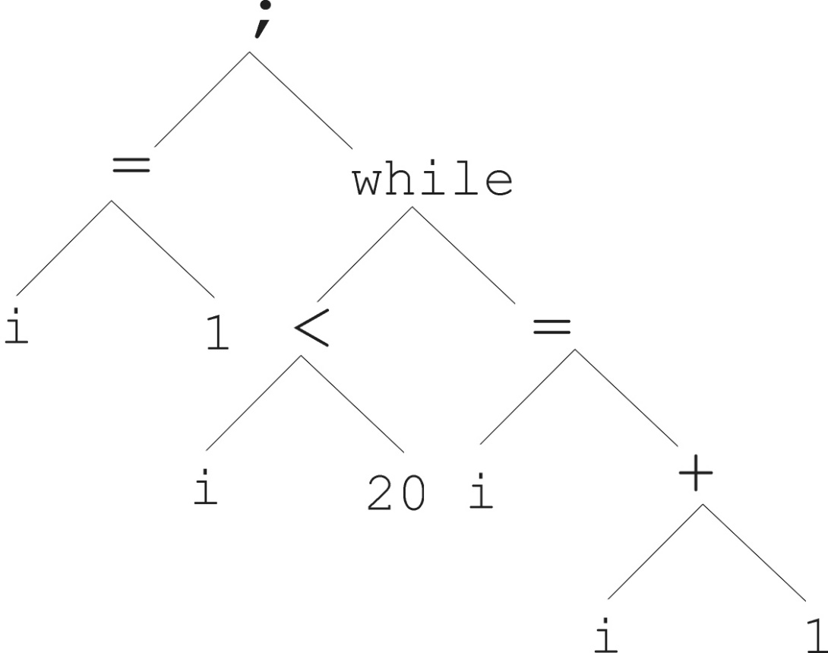
Tree-based representation
i =1;
while (i < 20)
{
i = i +1
}

Slide 12
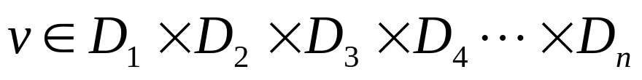
Tree-based representation
In GA, ES, EP, chromosomes are linear structures (bit strings, integer string, real-valued vectors, permutations).
Tree shaped chromosomes are non-linear structures
In GA, ES, EP the size of the chromosomes is (generally?) fixed.
Trees in GP may vary in depth and width.
requires new variation operators
(selection is irrelevant of representation)

Slide 13
Another view points on GP
  Strictly technical view point: simply a variant of GA working with a different data structure (the chromosomes are trees)
  Application-dependent interpretation:
    Programming of computers by means of natural selection
    Automatic evolution of computer programs, in the form of language LISP (or, Polish notation of expressions)

Slide 14
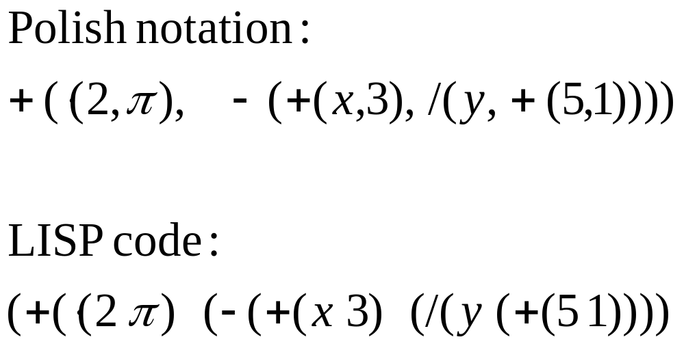

Slide 15

Tree-based representation
Symbolic expressions (s-expressions) can be defined by
  Terminal set T
    Elements of the Terminal set are leaves
  Function set F (with the arities of function symbols)
    Symbols from the Function set are internal nodes
Function set: {+,-,*,/}
Terminal set: { }

Slide 16
Adopting the following general recursive definition:
        Every t ∈ T is a correct expression
        f(e₁, …, e_{n}) is a correct expression if f ∈ F, arity(f)=n and (e₁, …, e_{n}) are correct expressions
        There are no other forms of correct expressions
In general, closure property holds for expressions in GP : any function can take any expression as argument. (Or, any f ∈ F can take any g ∈ F as argument)

Slide 17
Offspring creation scheme
Compare
GA scheme using crossover AND mutation sequentially in two consecutive steps (be it probabilistically)
GP scheme using crossover OR mutation in one step (chosen probabilistically)

Slide 18
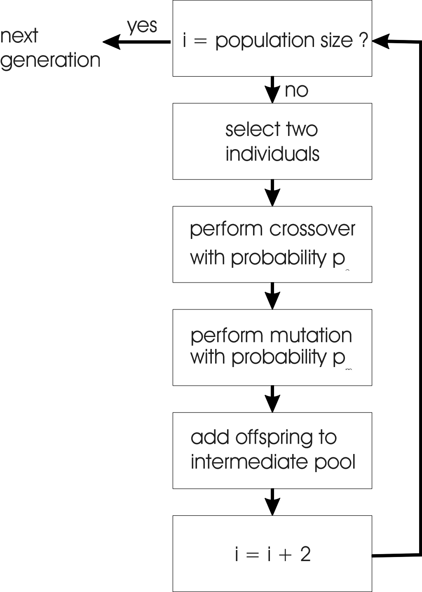
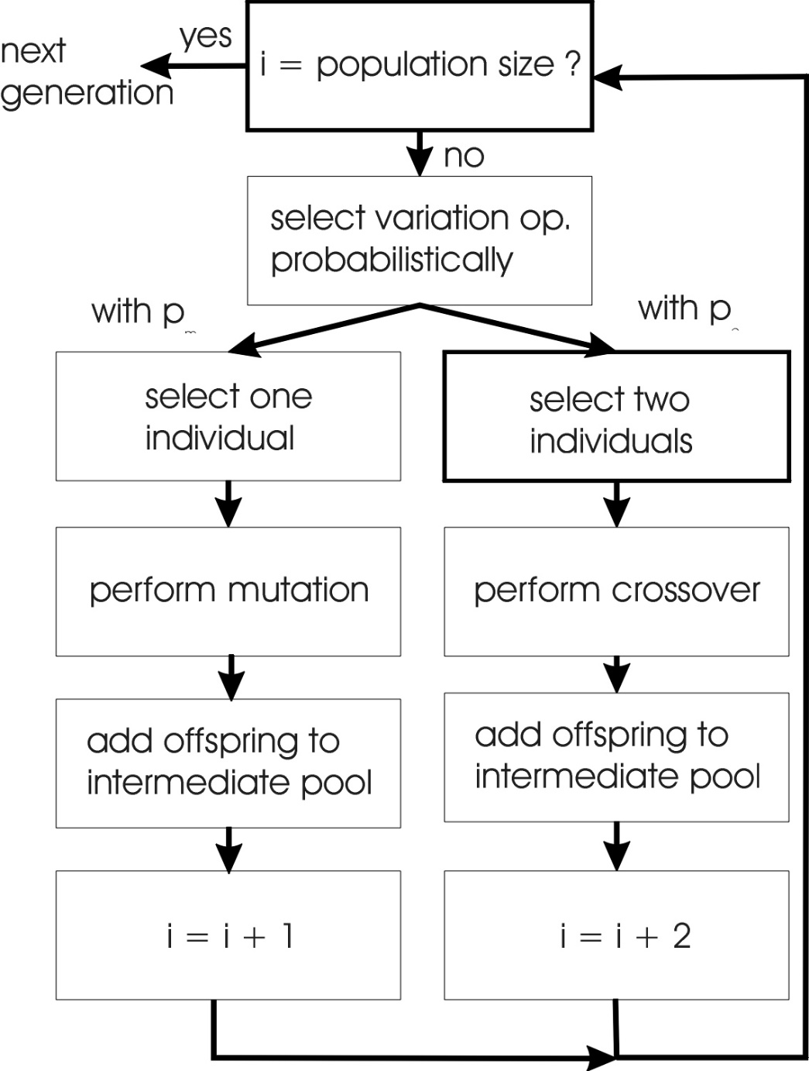
m
c
GA flowchart
GP flowchart
Notes:
Population size (Ex: 20)是已經經過selection 過的族群

Slide 19
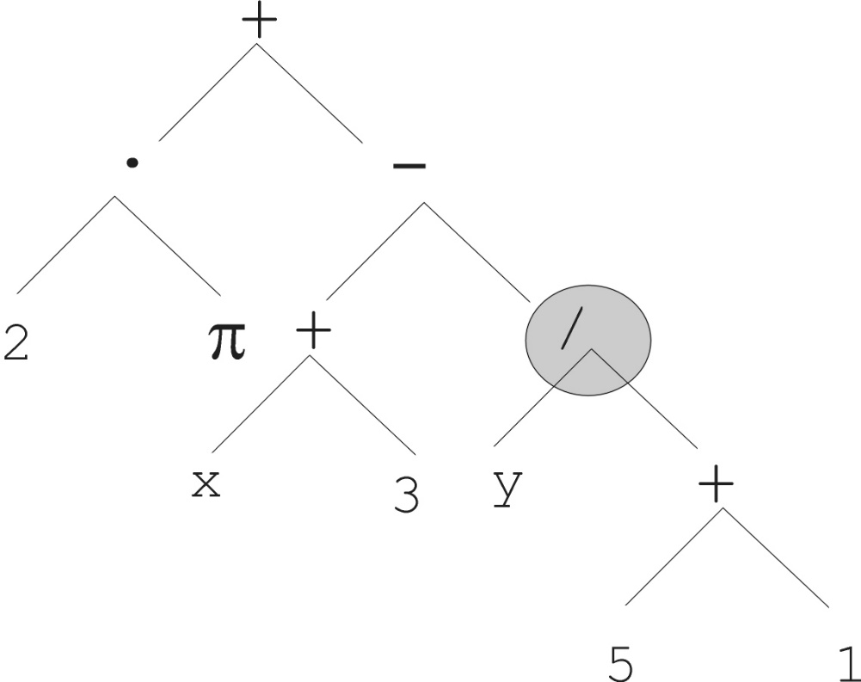
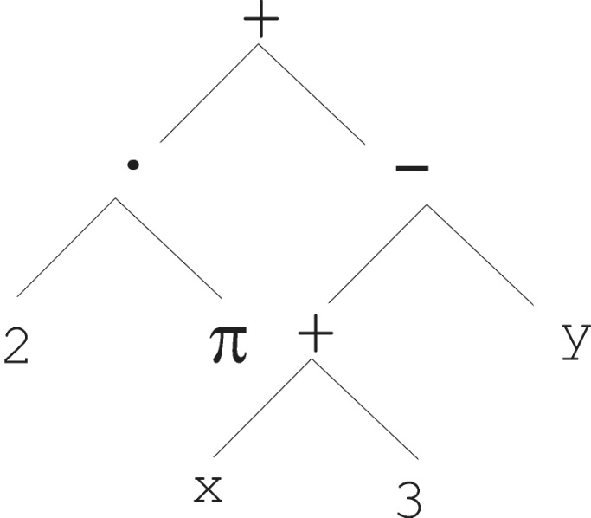

Mutation
Similar to all other EC branches
Create a new individual from an old one through some small random variation
Most common mutation: replace randomly chosen subtree by randomly generated tree
Selected for mutation

Slide 20
Mutation cont’d
Mutation has two parameters:
  Probability to choose mutation vs. recombination
  Probability to chose an internal point as the root of the subtree to be replaced
Remarkably, p_{m} is advised to be 0 (Koza’92) or very small, like 0.05 (Banzhaf et al. ’98)
  ➔limited role for mutation in GP
General view: crossover has a large shuffling effect, acting as macro-mutation operator.
General practice of GP: use low and positive mutation frequencies rather than pure crossover
The size of the child can exceed the size of the parent

Slide 21
Recombination
Most common recombination: sub-tree crossover exchange (swap) two randomly chosen subtrees among the selected parents.
Recombination has two parameters:
  Probability to choose recombination vs. mutation
  Probability to chose an internal point within each parent as crossover point
The size of offspring can exceed that of the parents, which is different from other EC variants

Slide 22
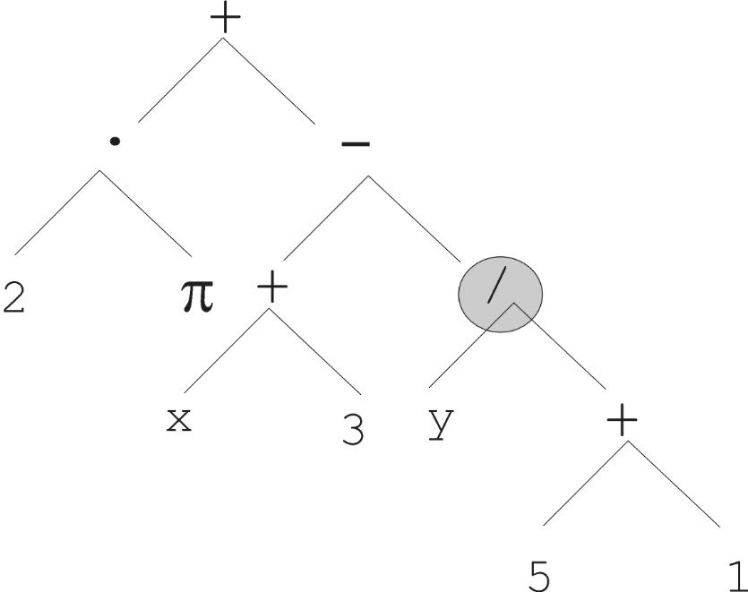
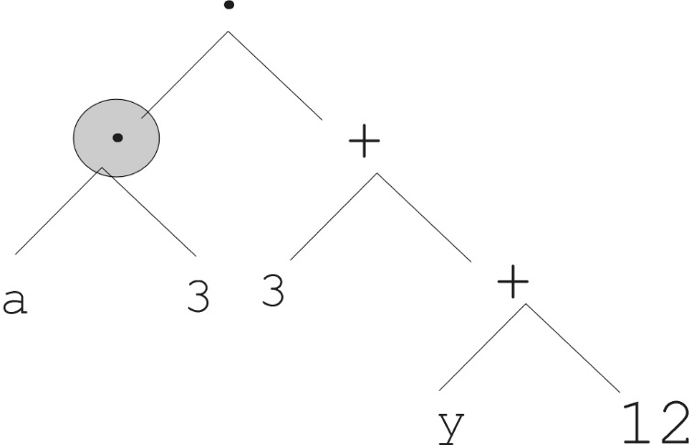
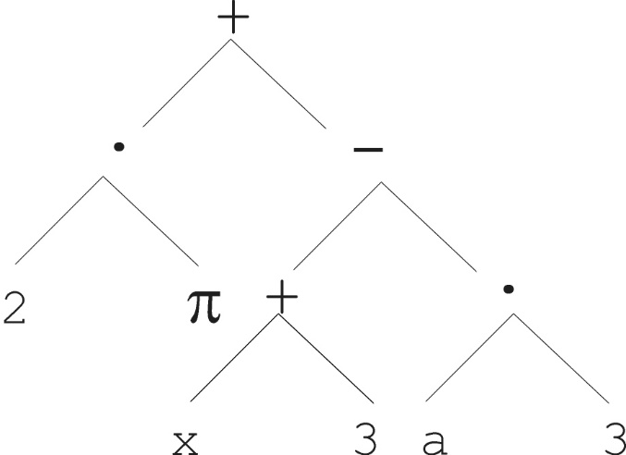
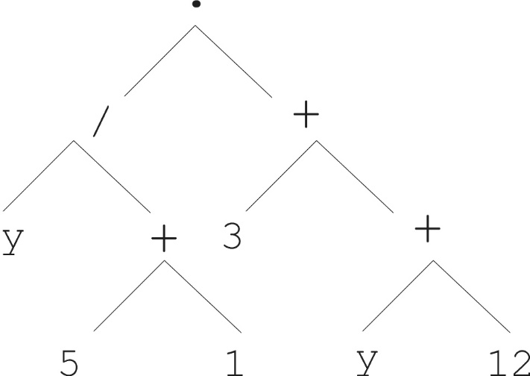
Parent 1
Parent 2
Child 1
Child 2

Slide 23
Selection
Parent selection typically fitness proportionate
Population size of several thousands are not unusual!
Over-selection in very large populations
  Suitable for population size over 1000
  rank population by fitness and divide it into two groups:
  group 1: best x% of population, group 2 other (100-x)%
  80% of selection operations chooses from group 1, 20% from group 2
  motivation: to increase efficiency, x is empirically found by rule of thumb
  Selection pressure dramatically increases for larger populations (given the fact that a fixed number of 320 chromosomes are selected from the majority of parents)

Slide 24
Pop Size | Proportion in the fitter group (x) | numbers
1000 | 32% | 320
2000 | 16% | 320
4000 | 8% | 320
8000 | 4% | 320

Slide 25
Survivor selection:
  Typically: generational scheme with no elitism (age-based)
    All individuals have a life span of one generation
  Recently steady-state scheme is becoming popular for its elitism, because of the need for elitism caused by the destructive effect of crossover. (fitness-based)

Slide 26
Initialisation
Maximum initial depth of trees D_{max} is set
Full method (each branch has depth = D_{max}):
  nodes at depth d < D_{max} , randomly chosen from function set F
  nodes at depth d = D_{max} , randomly chosen from terminal set T
Grow method (each branch has depth ≤ D_{max}):
  The branches of the tree have different depths
  nodes at depth d < D_{max} randomly chosen from F ∪ T
  nodes at depth d = D_{max} randomly chosen from T
Common GP initialisation: ramped half-and-half
  Grow & Full method each deliver half of initial population

Slide 27
Bloat
A special effect of varying chromosome size is that chromosome sizes tend to grow during a GP run.
Bloat = “survival of the fattest”, i.e., the tree sizes in the population are increasing over time
Ongoing research and debate about the reasons, however, NOT conclusive yet!
Needs countermeasures, e.g.
  To reduce or even eliminate tree growth range from elementary to highly sophisticated
  Simplest way to prevent bloat: introducing maximum tree size
  Prohibiting variation operators that would deliver “too big” children
  Parsimony (ungenerous) pressure: introduce a penalty term in the fitness formula that reduces the fitness of large chromosomes (being oversized)
  Multi-objective techniques (an extra objective function by minimizing chromosome size)

Slide 28
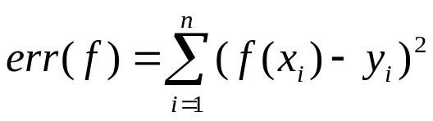
Example application: symbolic regression
Given some points in R², (x₁, y₁), … , (x_{n}, y_{n}), (i.e., data set )
Find a function f(x) s.t. ∀i = 1, …, n : f(x_{i}) = y_{i}
➔ Consider the given pairs (x_{i}, y_{i}) as data points, look for a function whose plot curve contains each data point. i.e., Curve fitting.
Possible GP solution:
  Representation by F = {+, -, *,/, exp, sin, cos}, T = R ∪ {x}
  Fitness is the error:
  Variation operators: standard mutation and recombination
  Pop.size = 1000, ramped half-half initialisation
  Parent selection: tournament selection with k=2, or fitness proportionate selection based on err(f)
  Termination: n “hits” or 50000 fitness evaluations (FE) reached (where “hit” is if | f(x_{i}) – y_{i} | < 0.0001, i=1,..,n)

Slide 29
Discussion
Example application: Robots playing soccer by an evolved controller
S. Luke, “Genetic programming produced competitive soccer softbot teams for RoboCup97”
Is GP:
The art of evolving computer programs?
Means to automated programming of computers?
GA with another representation?

